Slide 1
PRISM at Grover: Who, What, Where, When & How?
…and of course WHY!
September 2018

Slide 2
WHO is able to “do PRISM”?
Available to all students
Enrichment, not a replacement
Students must keep up with work in their core classes
Build and practice 21st Century Competencies
Performance Reveals Individual Student Magic

Slide 3
WHAT individual programs are included in PRISM?
Future Problem Solving - 6th, 7th & 8th
State Bowl Competition in March
International Competition in June
FPS Scenario Writing - 6th, 7th & 8th
Submitted in January
The Inquiry Project - 6th, 7th & 8th
Exposition at Grover in May
Replaced ROGATE
National History Day - 7th & 8th
Regional Competition in March
State Competition in May
National Competition in June
All programs begin in September / October

Slide 4
WHAT are other enrichment opportunities for students?
These are designed for ALL students, not only those in PRISM – they can be encouraged just to “check it out”
Workshops
Future Problem Solving – September
Research (NHD / Inquiry Project) – May
Scenario Writing – October
Lunch & Learn programs
Career exposure programs open to ALL students

Slide 5
WHAT does the PRISM year look like?
September – October
PRISM for All – introductory curriculum
October – January
Instruction and Training – FPS, NHD & Inquiry
January – March
Production and Refining – FPS, NHD & Inquiry
March – June
Competitions/Exposition – FPS, NHD & Inquiry

Slide 6
WHAT is this “PRISM for All” I keep hearing about?
Introductory curriculum
Multiple Intelligence Theory = Student Magic
Brain science – how to “plan around your brain”
Adolescent brain
Circadian rhythms
Right/Left brain
Keirsey Temperament
Gifts & Gaps
Wrap it up – what does this mean in school & beyond?

Slide 7
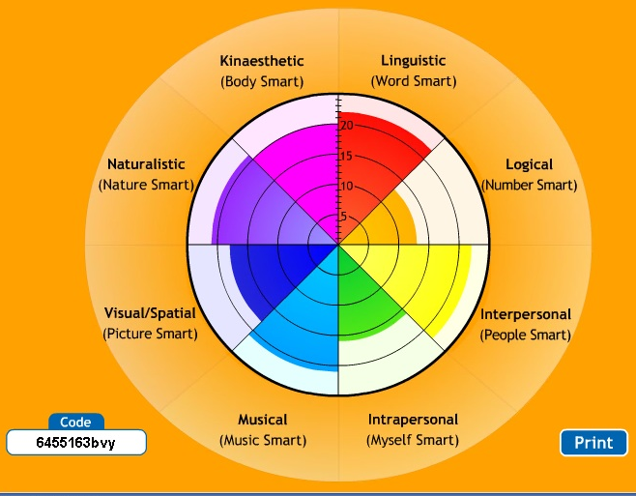
Multiple Intelligence Theory
We are not asking
“How smart are you” –
We are asking
“How are you smart?”

Slide 9
WHAT is Future Problem Solving?
Future Problem Solving (FPS) is an international program
Global Issues Team Problem-Solving
FPS Scenario Writing
All students' work is based around the internationally-designated topics for that particular school year
Moon, Mars & Beyond - Practice Problem #1
Drones - Practice Problem #2
Food Loss & Waste - Qualifying Problem
Coping with Stress - State Bowl Problem
International Competition at University of Massachusetts in June

Slide 10
WHAT is The Inquiry Project?
A year-long research project
Students who choose to pursue an Inquiry Project research ANY topic OF THEIR CHOICE
Research, analysis, synthesis and evaluation are the critical thinking skills that must be applied for solid research work
The final step is to learn how to present the research effectively at a Spring exposition
Inquiry Project work is about research, intellectual problem-solving, and learning to communicate ideas effectively.

Slide 11
WHAT is National History Day?
A year-long research project
NHD is a competition that provides opportunities for gifted students to pursue research in ANY topic, as long as that topic has some "history" to consider
Usually something that happened at least forty years ago, so the impact can be analyzed over at least a generation
Students can compete as individuals in the categories of Exhibit, Performance, Documentary, Website, or Paper.
Regional Competition – March
State History Day – May
National History Day – June

Slide 12
HOW can students participate in PRISM?
At Grover, the opportunity is available to ALL students
6th graders: presentations in September/October
7th & 8th graders: workshops and announcements
“PRISM for All” foundation curriculum in September
Students decide whether to stay or “revolve out”
All students sign a PRISM contract
Attendance
Behavior
Deadlines
Students who cannot meet requirements in any of these areas “revolve out” of the PRISM program and then have the opportunity to “revolve back in.”

Slide 13
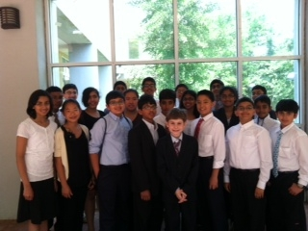
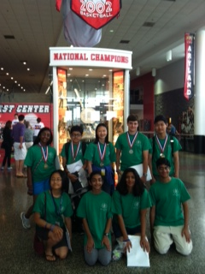
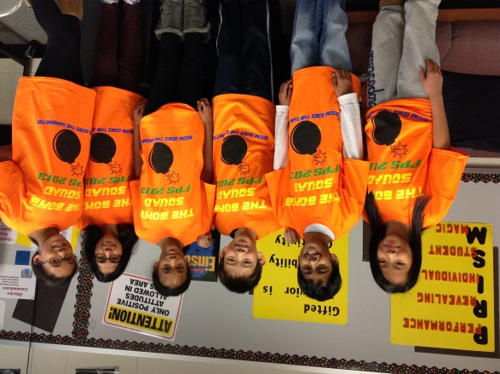
HOW can I learn more?
View student work every June at PRISM Presents
Attend / judge at a competition or exposition
Present a Lunch & Learn

Slide 14
Please contact me if you have questions
or to volunteer ~
Thank you!
debra.cohen@ww-p.org

